Slide 1
Twitch Channels Performance Analysis
Insights and Findings
Analyzed By Renad Majed

Slide 2
Content
Objective 1: Analyze the performance metrics of 1,000 Twitch channels.
Objective 2: Examine the characteristics of partner channels.
Objective 3: Assess viewer engagement and language preferences.

Slide 3
introduction
In this analysis, I explore the performance of Twitch channels.
Understanding channel dynamics is crucial for content creators and marketers.

Slide 4

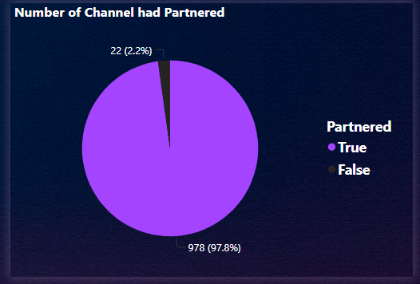
Overview of Data Total Number of Channels: 1,000 Number of Partner Channels: 978 Percentage of Partner Channels: 97.8% Non-Partner Channels: 22 (2.2%)

Slide 5
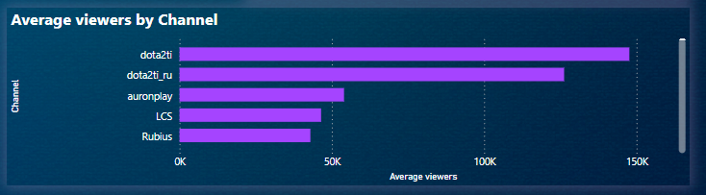
Viewer Engagement
Average Viewers per Channel: @dota2ti
This metric indicates the level of popularity and viewer retention across channels.

Slide 6
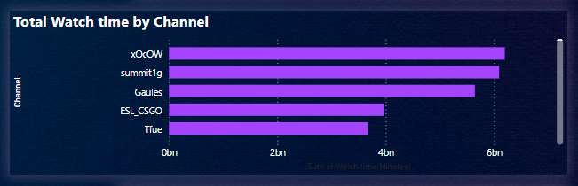
Total Watch Time
Total Watch Time by Channel: @xQcow
Watch time is a critical metric for assessing overall channel performance.

Slide 7
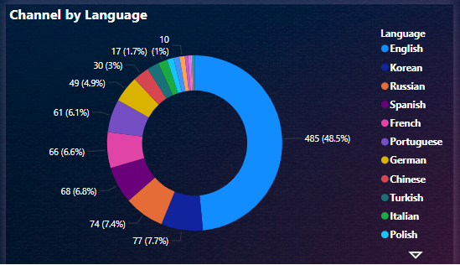
Language Analysis
Dominant Language: English
The majority of channels primarily use English

Slide 8
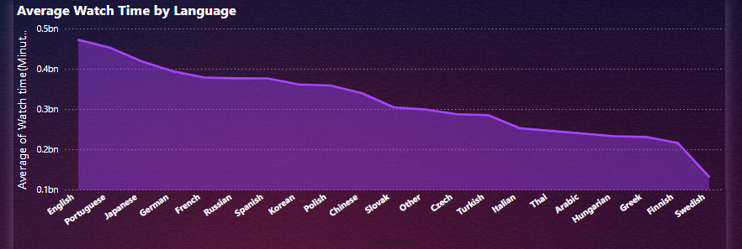
Language Analysis
Dominant Language: English
English channels show the highest viewer engagement, impacting overall performance.

Slide 9
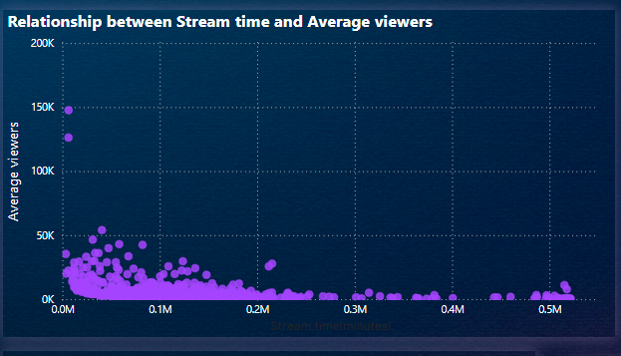
Relationship Between Stream Time and Average Viewers
Finding: A negative correlation between stream time and average viewers.
Possible explanations include viewer fatigue or content saturation.

Slide 10
Recommendations
Focus on quality content over quantity of stream time.
Engage effectively with the English-speaking audience for maximum impact.
Non-partner channels should explore collaboration opportunities with partner channels to enhance visibility and views.

Slide 11
THANK YOU

